Slide 1
RSA Algorithm

Slide 2
Preliminaries
Two positive integers, a and b, are relatively prime, or coprime, if gcd (a, b) = 1.
Euler’s Phi-Function/ Euler’s totient function φ(n): The function finds the number of integers that are both smaller than n and relatively prime to n. The set Z_{n}* contains the numbers that are smaller than n and relatively prime to n. The function φ(n) calculates the number of elements in this set. The following helps to find the value of φ(n).
1. φ(1) = 0.
2. φ(p) = p − 1 if p is a prime.
3. φ(m × n) = φ(m) × φ(n) if m and n are relatively prime.
4. φ(p^{e}) = p^{e} − p^{e−1} if p is a prime.
The difficulty of finding φ(n) depends on the difficulty of finding the factorization of n.
What is the value of φ(13)?
Because 13 is a prime, φ(13) = (13 −1) = 12.
What is the value of φ(10)?
Using third rule: φ(10) = φ(2) × φ(5) = 1 × 4 = 4, because 2 and 5 are primes.
What is the value of φ(240)?
240 = 2⁴ × 3¹ × 5¹. Then φ(240) = (2⁴ −2³) × (3¹ − 3⁰) × (5¹ − 5⁰) = 64.
Can we say that φ(49) = φ(7) × φ(7) = 6 × 6 = 36?
No. The third rule applies when m and n are relatively prime. Here 49 = 7². So, using fourth rule: φ(49) = 7² − 7¹ = 42.
What is the number of elements in Z₁₄*?
The answer is φ(14) = φ(7) × φ(2) = 6 × 1 = 6. The members are 1, 3, 5, 9, 11, and 13.

Slide 3
Preliminaries Contd.
Multiplicative Inverse: In Z_{n} , two numbers a and b are the multiplicative inverse of each other if
a × b ≡ 1 (mod n).
In modular arithmetic, an integer may or may not have a multiplicative inverse.
a has a multiplicative inverse in Z_{n} if and only if gcd (n,a) = 1. In this case, a and n are said to be relatively prime.
Find the multiplicative inverse of 8 in Z₁₀.
There is no multiplicative inverse because gcd (10, 8) = 2 ≠ 1.
Find all multiplicative inverses in Z₁₀.
There are only three pairs: (1, 1), (3, 7) and (9, 9). The numbers 0, 2, 4, 5, 6, and 8 do not have a
multiplicative inverse.

Slide 4
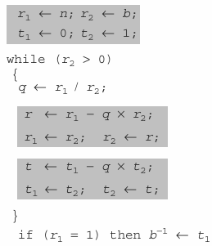
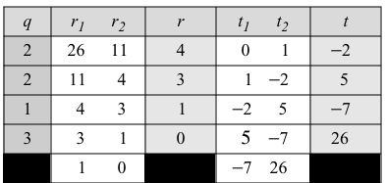
Preliminaries Contd.
Extended Euclidean Algorithm for finding Multiplicative Inverse:
We are interested only in the value of t. t1 is the multiplicative inverse.
Find the multiplicative inverse of 11 in Z₂₆.
The gcd (26, 11) is 1, which means that the multiplicative inverse of 11 exists. The extended
Euclidean algorithm gives t1 = −7. The multiplicative inverse is (−7) mod 26 = 19. In other words,
11 and 19 are multiplicative inverse in Z26. We can see that (11 × 19) mod 26 = 209 mod 26 = 1.

Slide 5
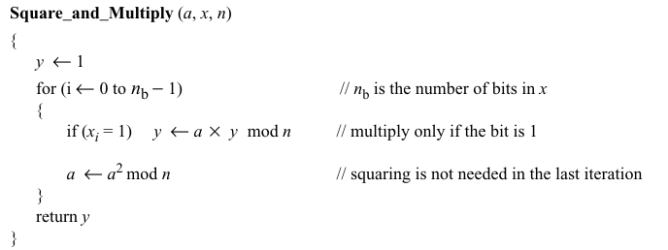
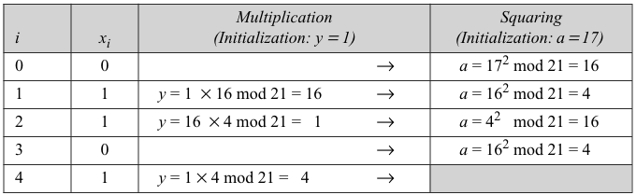
Preliminaries Contd.
Fast Exponentiation Algorithm:

Slide 6
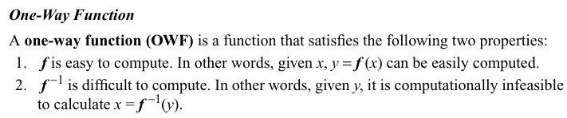

Preliminaries Contd.
When n is large, the function y = x^{k} mod n is a trapdoor one-way function.
Given x, k, and n, it is easy to calculate y using the fast exponential algorithm.
Given y, k, and n, it is very difficult to calculate x. This is the discrete logarithm problem. There is
no a polynomial time solution to the f⁻¹ function in this case. However, if we know the trapdoor, k′
such that k × k′ = 1 mod φ(n), we can use x = y^{k′} mod n to find x.

Slide 7
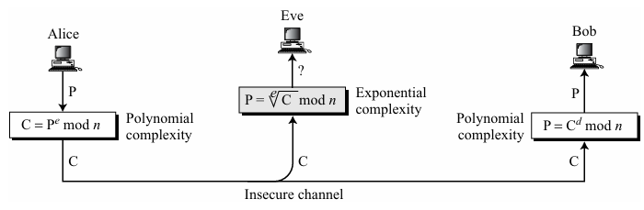
RSA Cryptosystem
Inventors: Ron Rivest, Adi Shamir, and Leonard Adleman in 1977
Complexity of operations in RSA

Slide 8
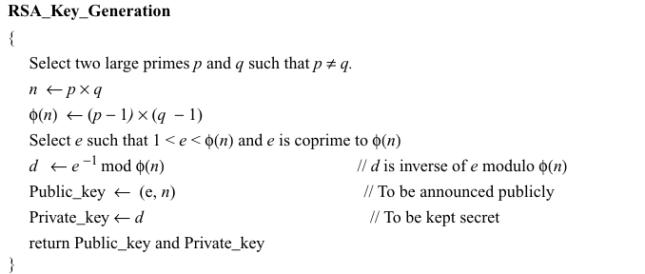
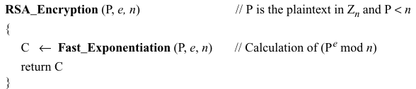
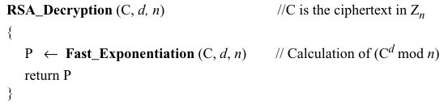
RSA Algorithm
d×e≡1(mod ϕ(n))

Slide 9
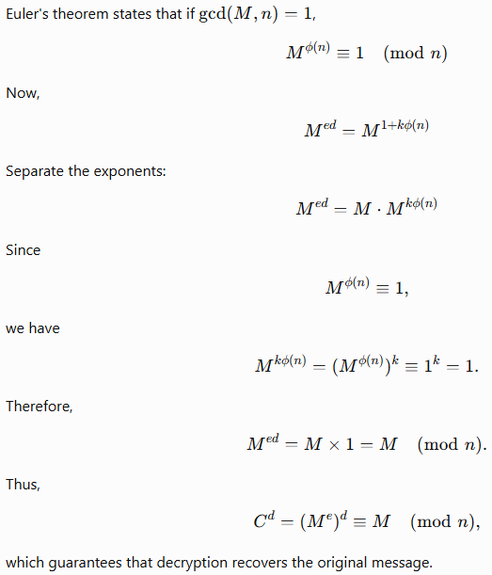
RSA Proof

Slide 10
Problem
Consider: p=61, q=53, message, P = A. Execute RSA.

